Slide 1
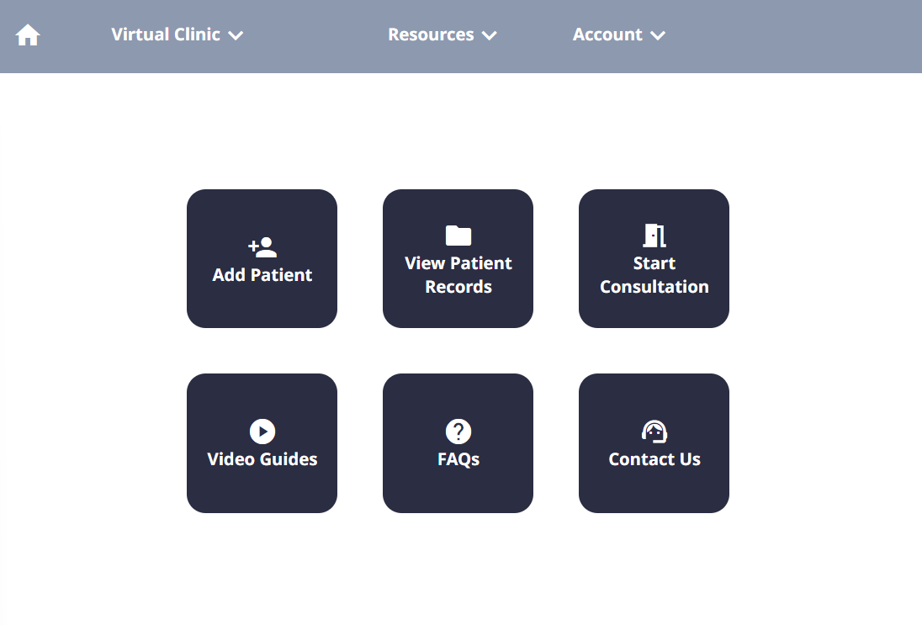
Welcome to Tutorial 3.
Let’s jump in and start the consultation again for James Jameson.

Slide 2
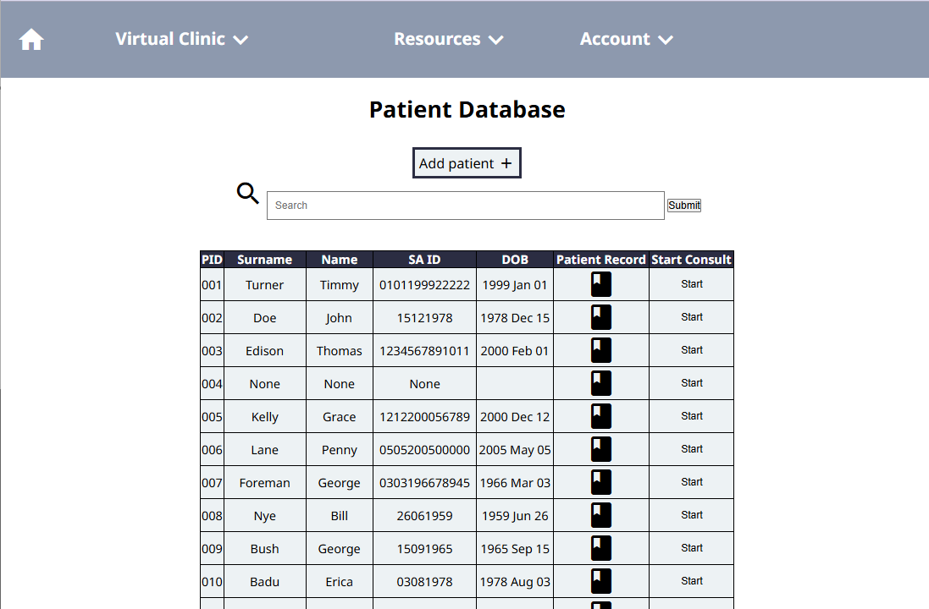
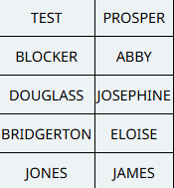

Slide 3
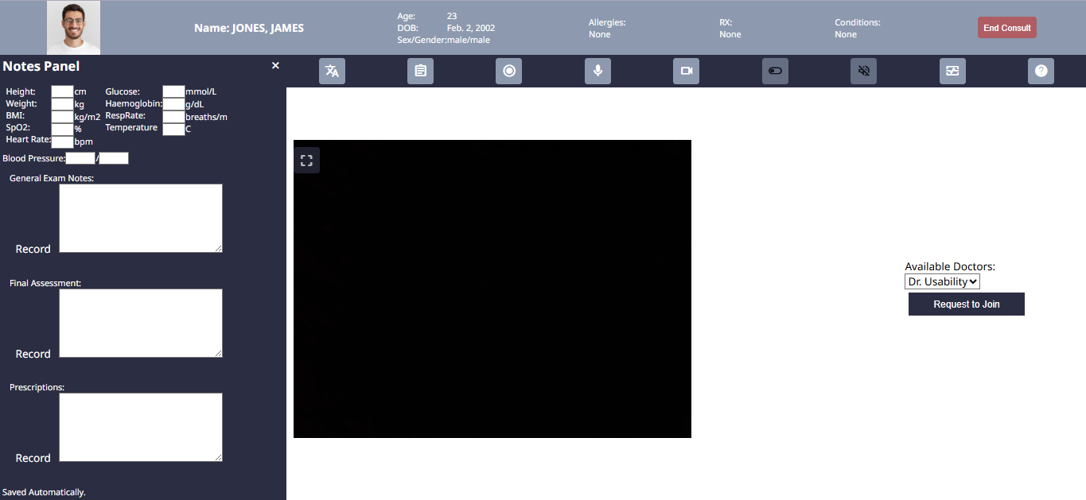


Start once again by recording the session.

Slide 4
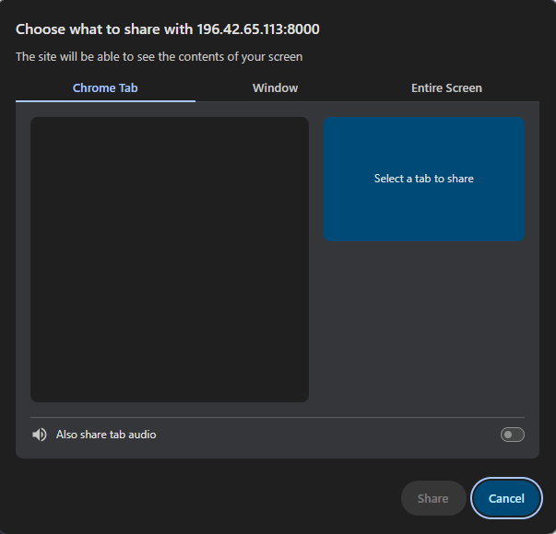

Slide 5
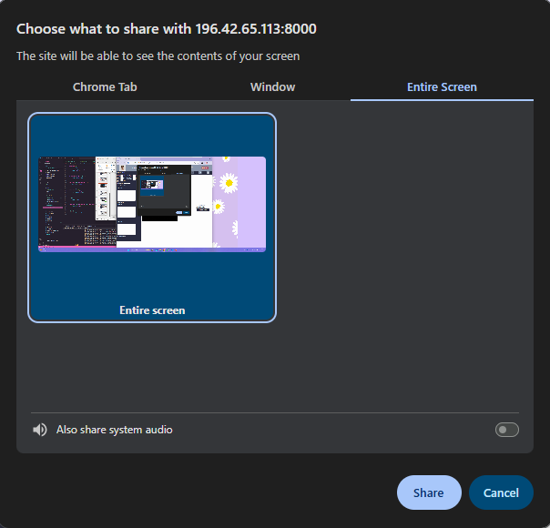

Slide 7


Slide 8
Great. Now let’s get started.
Your patient today is complaining of feeling some irregular heart beats during their daily activities.
They do not have any previously recorded conditions.
Click to continue →

Slide 9
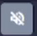
The doctor wants to start by listening to their heartbeat with the stethoscope.
Start by plugging in the stethoscope to the computer.
Then, click the stethoscope button on the top menu (hint: looks like a speaker)

Slide 10
Great! You have now turned on the stethoscope.
Now, when you turn on the stethoscope, the doctor will not hear you speaking any more. They will only hear the stethoscope sounds.
To speak to the doctor again, press the same button to turn off the stethoscope sound.

Slide 11
The doctor comments that he does not hear any issues, but he would like to confirm further by performing an ECG.
Now, you will practice how to conduct an ECG exam.
Click to continue →

Slide 12
You’ll start by opening up the ECG panel.
Click the ECG button to open (hint: it looks like a monitor with an ECG on it).

Slide 13
You will now see an option to start an ECG reading at the bottom of the page.
Before you start the reading, set up your patient with the ECG electrodes and connect the leads to the monitor.
Once you have completed this, click ‘Start ECG Reading’

Slide 14
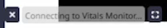
Great. The platform will now connect to the monitor. However, it needs to connect via Bluetooth to do so.
Follow the Bluetooth connection process to make sure that the device connects.
Click to continue →

Slide 15
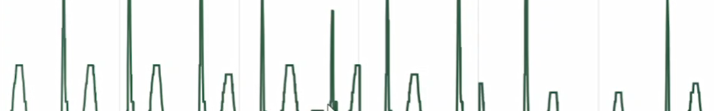
The ECG reading will appear when the test is complete. This chart is automatically sent to the doctor.
Multiple ECG readings can be taken – just press the ‘Start ECG Reading’ button again. Remember to follow the Bluetooth connection process each time a reading is taken.
Click to continue →

Slide 16
The doctor says that the ECG looks normal, but would like to document it to the patient record for future use.
Take a screenshot of the ECG chart by using the screenshot icon next to the ‘Start ECG Reading’ button.

Slide 17
Great! The consult is over now. You can end the consult.

Slide 18
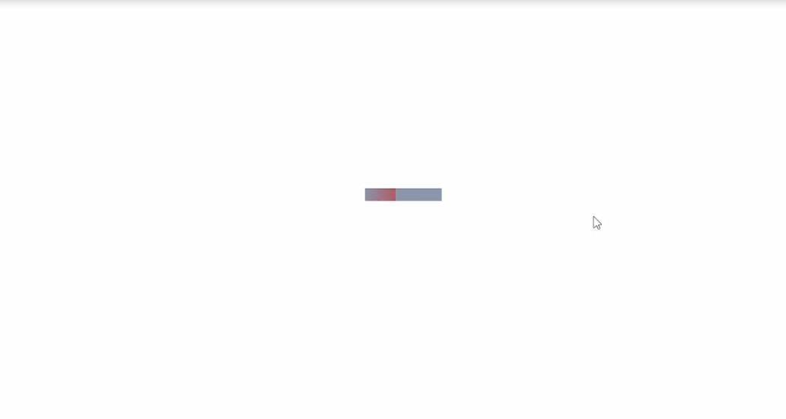
Remember not to exit out or change the page while it’s loading!
Click to continue →

Slide 19
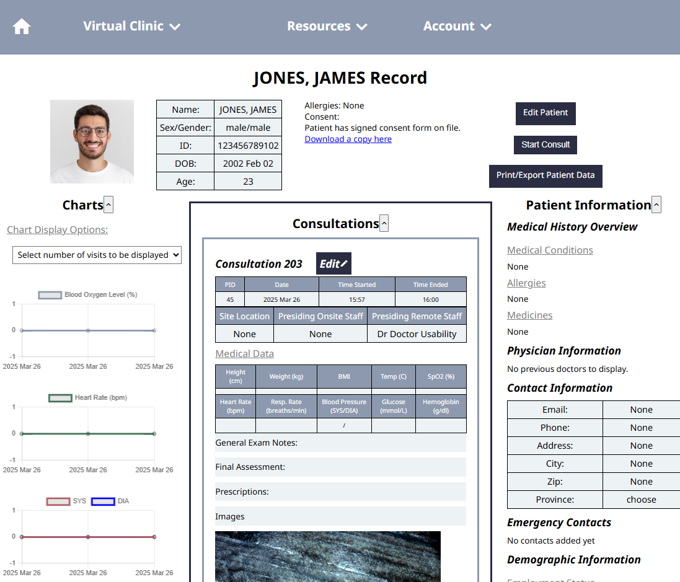
Great! The ECG is now saved on the patient’s record.
37
99
120
80
Click to continue →

Slide 20
Congrats! You have finished your Tutorial 3.
You now know how to:
Use the stethoscope
Take an ECG reading
You are now ready to try the last tutorial.

